Slide 1


Psychological Measurement Week 1 Dimensionality
Dr Oliver Clark (oli)

Slide 2
This Video
Dimensha-what?
Single factor constructs
Subscales
Parallel Analysis

Slide 3
Dimensionality
Extraversion
I like to party
I enjoy socialising
I can’t get a word in edgeways ®

Slide 4
Dimensionality
Rape Myth Acceptance
‘She asked for it’
‘He didn’t mean to’
‘She lied’
If a woman is raped while she is drunk, she is at least somewhatresponsible for letting things get out of control
When men rape, it is because of their strong desire for sex
Rape accusations are often used as a way of getting back at men.
Payne et al (1999)

Slide 5
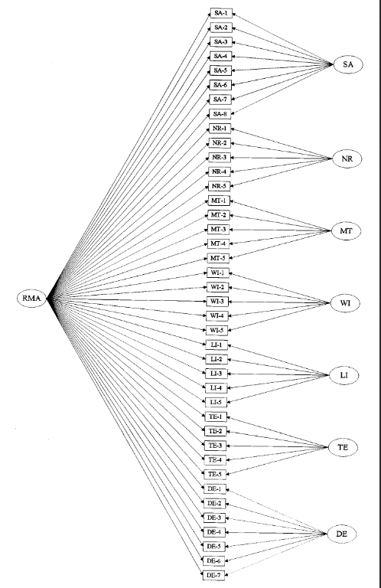
Dimensionality
Payne et al (1999)

Slide 6
Dimensionality
Factors
General Intelligence (g)
Verbal
Non-verbal
Numerical

Slide 7
General Factor? Revelle & Wilt (2013)
Neuroticism
Item 1
Item…
Item 10
Factors
Extraversion
Item 1
Item…
Item 10
Conscientiousness
Item 1
Item…
Item 10
Openness to Change
Item 1
Item…
Item 10
Agreeableness
Item 1
Item…
Item 10

Slide 8
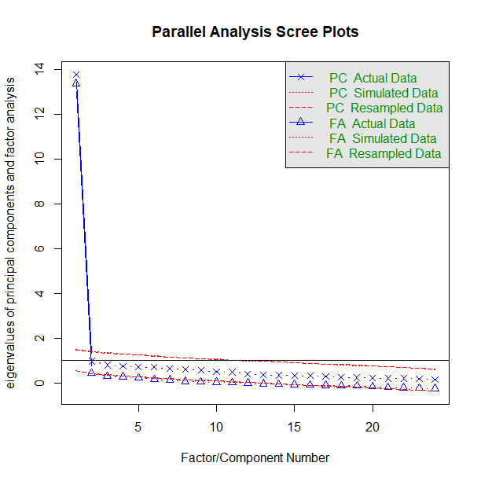
Parallel Analysis

Slide 9
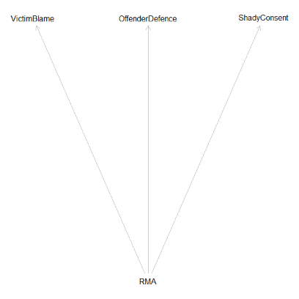
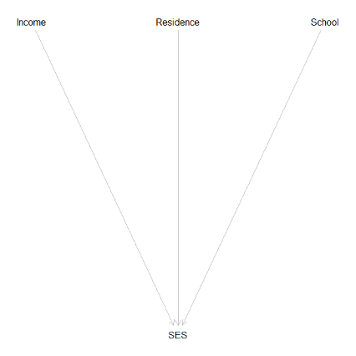
Components?
Factors
Principal Components

Slide 10
How does this relate to measurement?
We need to know whether and how our items are reflecting a latent variable
We need to ensure that we meet the assumptions of later tests
We need confidence in our data

